Slide 1
NORMAL DEVELOPMENT OF FEMALE GENITAL TRACT
Presnted by professor muhsin al-sabbak
Consultant gynecologist
Basrah medical school
2020----2021

Slide 2
Learning objectives:-
1-Explain how tissues differentiated in to male or female organs.
2- Name the rudimentary duct system in the embryo that is precursors to male or female internal sex organs.
3-What hormones that bring puberty and secondary sex character?
4- Able to define certain terms in the lecture like Mullerian, Wolffian, Mesonephric and so on.

Slide 3
SEX DETERMINATION
Sex is determined at the time of fertilization to either a female of 46XX or a male with a genotype of 46XY or to any other congenital sex anomalies according to the type of genotype that resulted after fertilization immediately.
The development of reproductive system begin soon after fertilization of the egg,
beginning to develop approximately one month after conception.
During the first meiotic division 46 XX divided in to 23 X and 23 X and the male chromosome divide in to 23 X and 23 Y so the result will be 46XX,46XY,46XX and 46XY.
X chromosome is incompatible with life.

Slide 4
But if non disjunction occurred during the first meiotic division the result will be 46 XX will divide to 23 XX and 22 0 while the 46 XY will divide to 23 X and 23Y.
So the result will be as the followings:-
47 XXX called super female.
47 XXY called Klinfilter syndrome.
45 XO Turner syndromes
45 YO incompatible with life as any genotype pattern with absence of at least one

Slide 5
Female considered as fundamental sex that is without much chemical prompting all fertilized egg will develop into female.
To become a male an individual must be exposed to cascade of factors initiated by a single gene called the SRY gene sex determining region of the Y chromosome because female don’t have Y chromosome, they don’t have SRY gene. Without functional SRY gene, an individual will be female.

Slide 6
Development of the gonads
The mesenchyme cells of the coelom on the medial aspect of the intermediate cells mass and the underlying mesodermal cells proliferate to form the genital ridge which is apparent in the cervical and thoracic region of the 4-5 weeks old embryo.
This elongated mass of the undifferentiated cells in the sex gland became later either testis or ovary depend on the presence or absence of HY antigen (Y chromosome or the absence respectively.

Slide 7
If Y chromosome is present the medullary portion will proliferate, if not, the cortical one will proliferate and lead to the formation of future ovary.
Sexual differentiation of the gonads is recognized by 6th weeks of gestation 17 CRL (crown rump length).
The ceolomic cells forms the germinal (surface epithelium) cortex of the ovary while the underlying mesoderm give rise to the medulla.

Slide 8
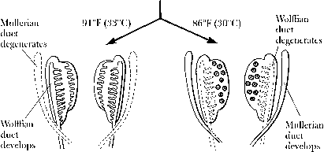

Slide 9
Differentiations of the gonads:-
As early as the 5th week of gestation of the embryonic life the site of development of the gonads can be recognized as thickening of the ceolomic epithelium over the ventral aspect of the mesonephros.
Amoeboid cells which are the primordial germ cells migrate to form distinct sex cords. By 16 weeks of gestation the primary oocyte can be distinguished these cells later form the granulosa cells.
At 20 weeks of gestation the ovary is consist of 7 million of germ cells but at birth they became 2 million and at puberty they are less than half million.

Slide 10
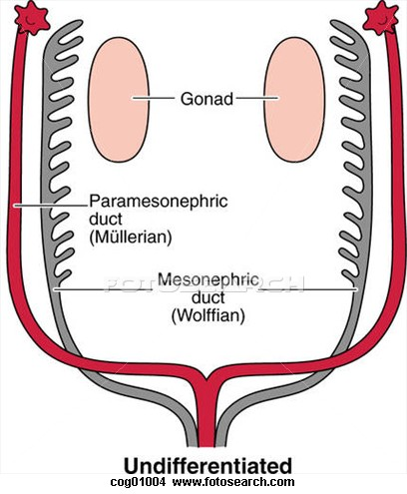

Slide 11
Development of female genital tract:-
In the absence of testis the Mullerian system will develop and the Wolffian duct will obliterate leaving only Gardner duct cyst which are congenital ruminant of Wolffian ducts.
The Mullerian duct will proliferate and will form future fallopian tubes, uterus, cervix and upper 4/5th of the vagina while the lower 1/5th formed by the urogenital sinus.
In the presence of HY antigen and Y chromosome these will produce the ante Mullerian factor (M.I.F) Mullerian Inhibitory factor and this will intern lead to obliteration of the Mullerian duct and proliferation of the medullary duct and formation of future testis.

Slide 12
So if HY is present male will develop and if testis is absent female genital tract will develop whether ovaries present or absent.
So formation of female sex is passive process because it is formed in the absence of Y chromosome.
By the 6th weeks of gestation the gonad still indifferent gonad but there after the gonads can be differentiated to either an ovary or testis.
By the 12th weeks of gestation the cortical cells of the ovary will proliferate to a much greater extent than that of the male resulting in a crowded cells mass that cover the ovary.

Slide 13
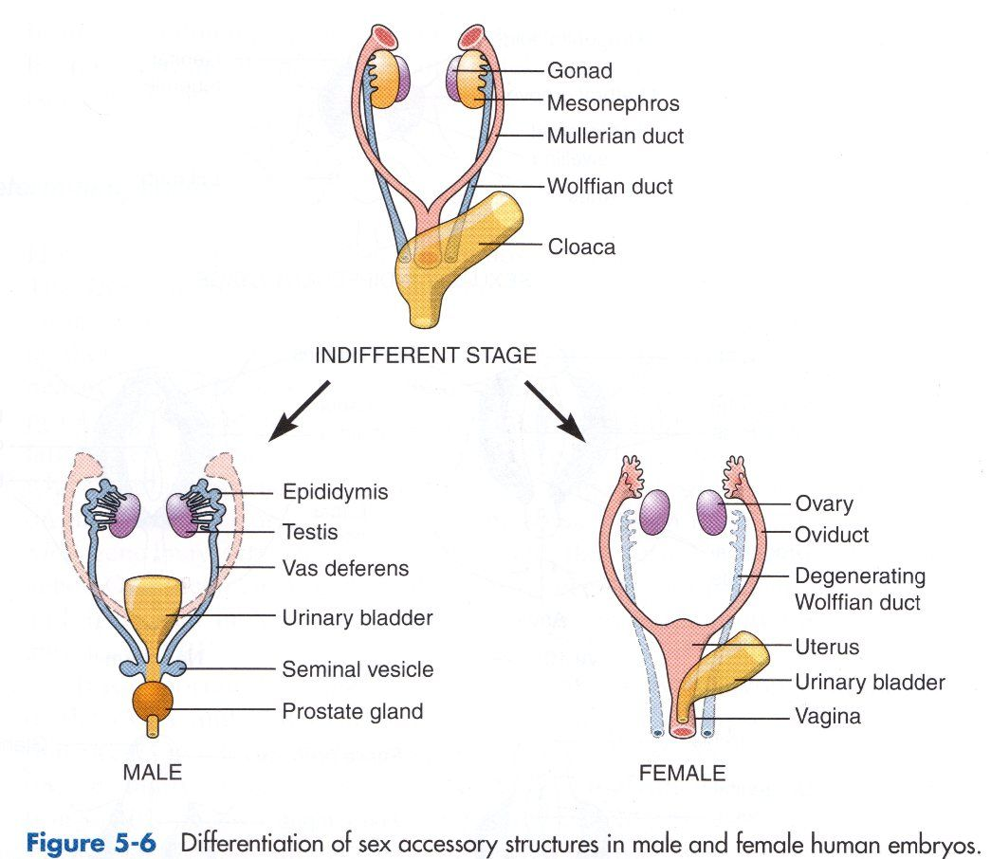

Slide 14
Later sexual differentiation:-
The ovary will produce estrogen and progesterone under the influence of gonado- trophin hormones FSH and LH which are secreted by the anterior pituitary gland.
These hormones will form the secondary sexual developments of the female which are breast buds, pubic hair, axillary hair and finally menarche.
Hypothalamus secrete GT RH (gonadotrophin releasing hormone) which act on the anterior pituitary to secreate gonadotrophin FSH and LH (follicular stimulating hormone and lutinising hormone) which in turn affect the ovary to produce estrogen and progesterone all these event happened at puberty.

Slide 15
Audio visual stimulation―――hypothalamous stimulation------------ release GTRF (gonadotrophin releasing factor) ------------ stimulation to the pituitary gland --------- release FSH and LH ------------ stimulation of ovary to release estrogen and progesterone (ovarian cycle)-----------stimulation to the uterus to initiate the menstrual cycle (proliferative and secretory phase)---------feedback inhibition for no more release of FSH.

